Slide 1
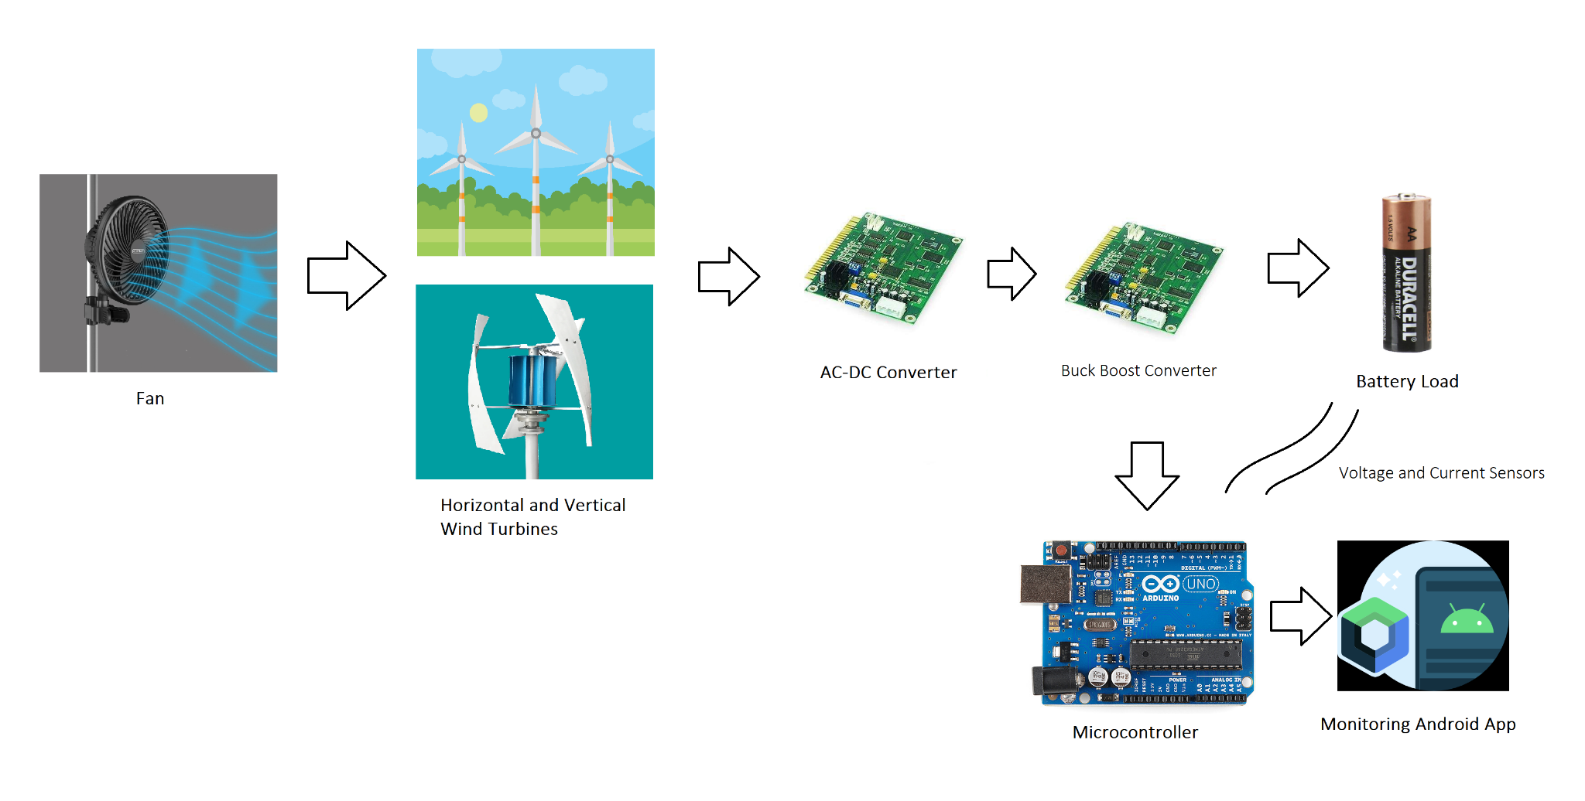
Team 12: Wind Power
System Block Diagram and Description

Slide 2
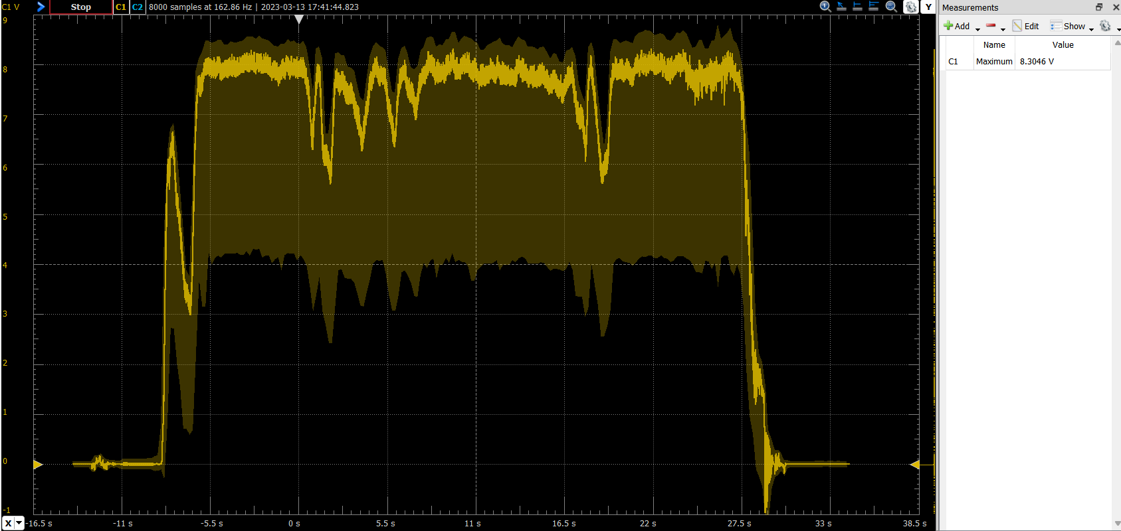
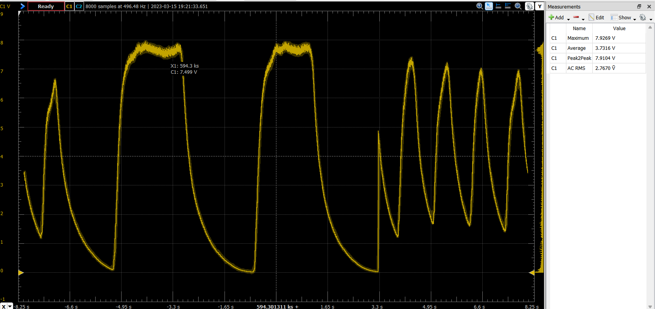
Power Subsystem Samuel Tando
Accomplishments since the last presentation | Ongoing progress/problems and plans until the next presentation
Designed and simulated AC/DC and Buck Boost <4> Tested generator output values <1> Assembled prototype AC/DC <1> Tested AC/DC output <2> Research Parts <3> | Need to get voltage regulator, finalize buck boost design.

Slide 3
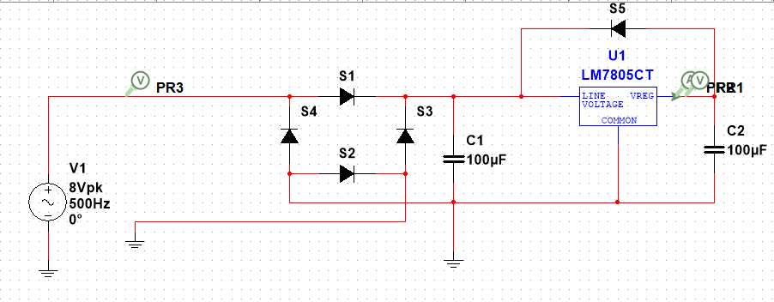
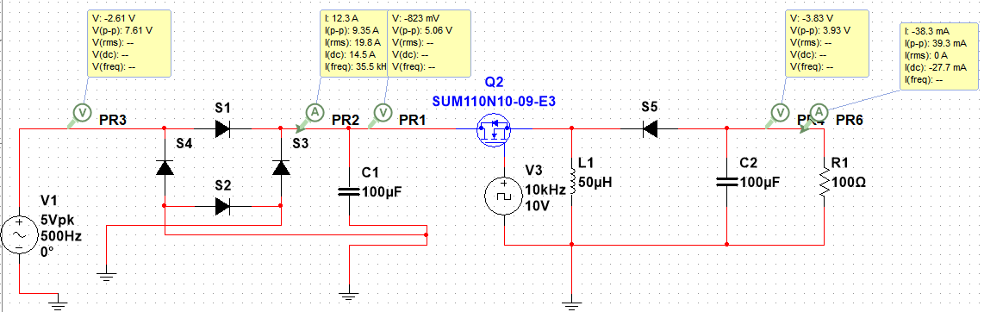
Power Subsystem Cont.
Multisim Simulations
AC/DC and Combined circuits

Slide 4
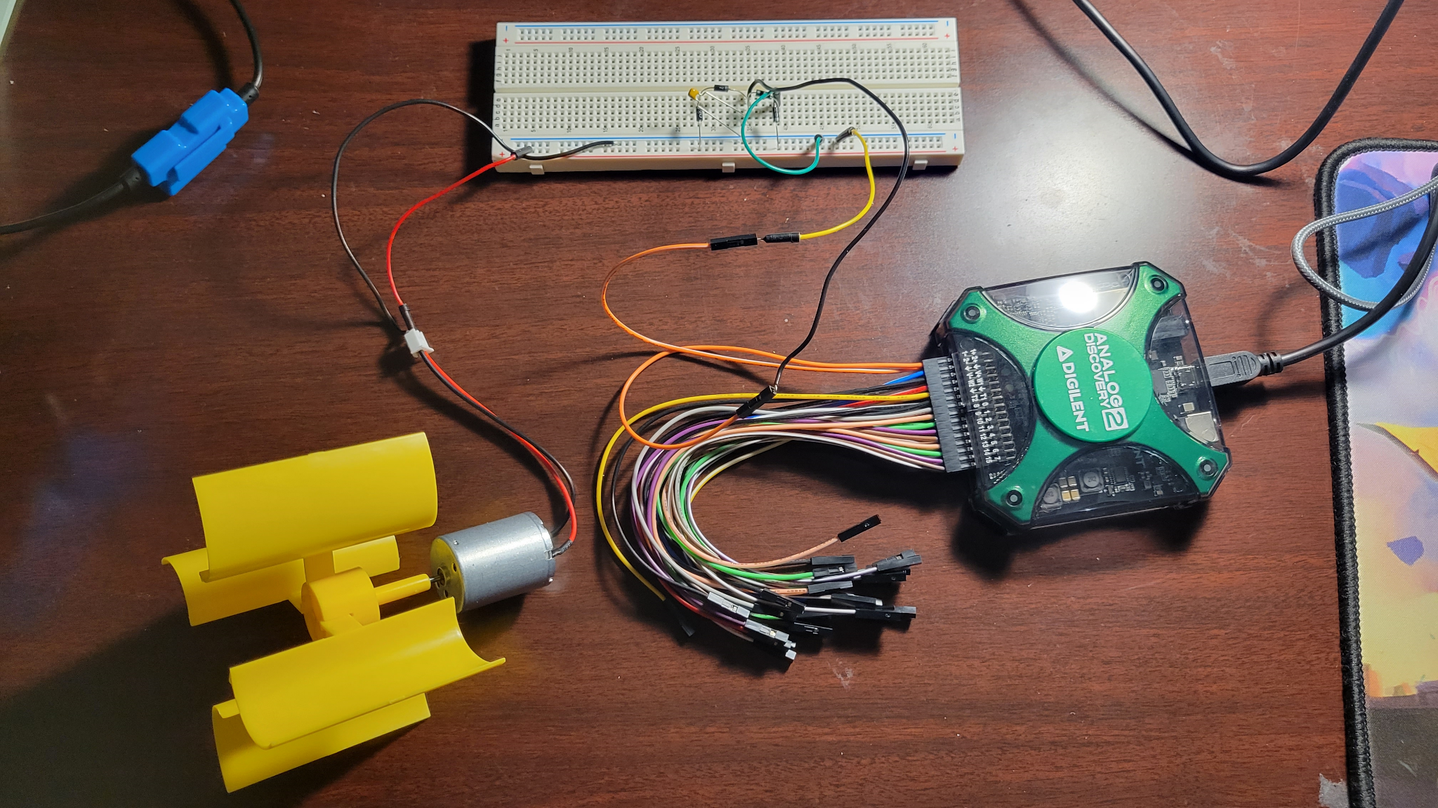
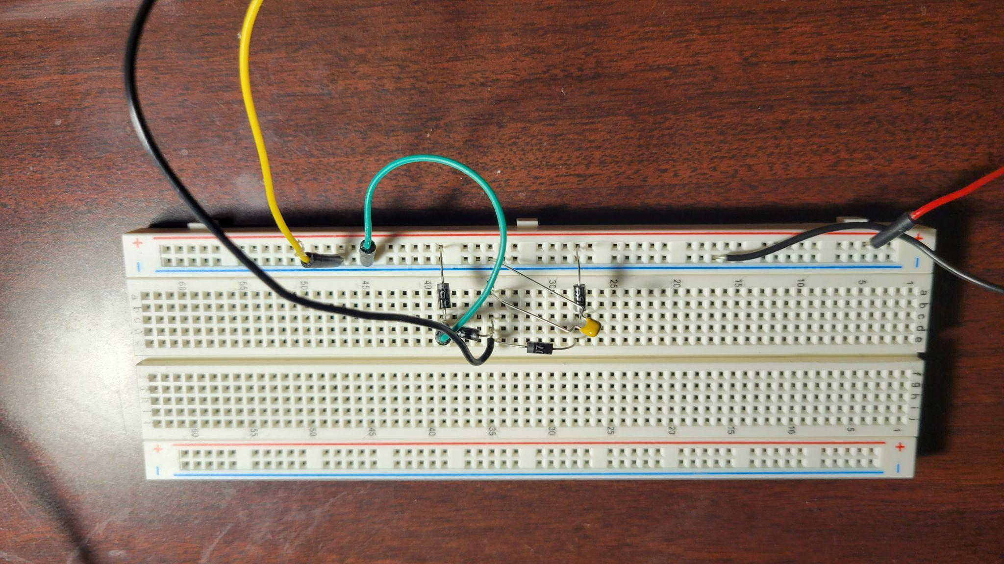
Power Subsystem Cont.
AC/DC Prototype and generator testing

Slide 5
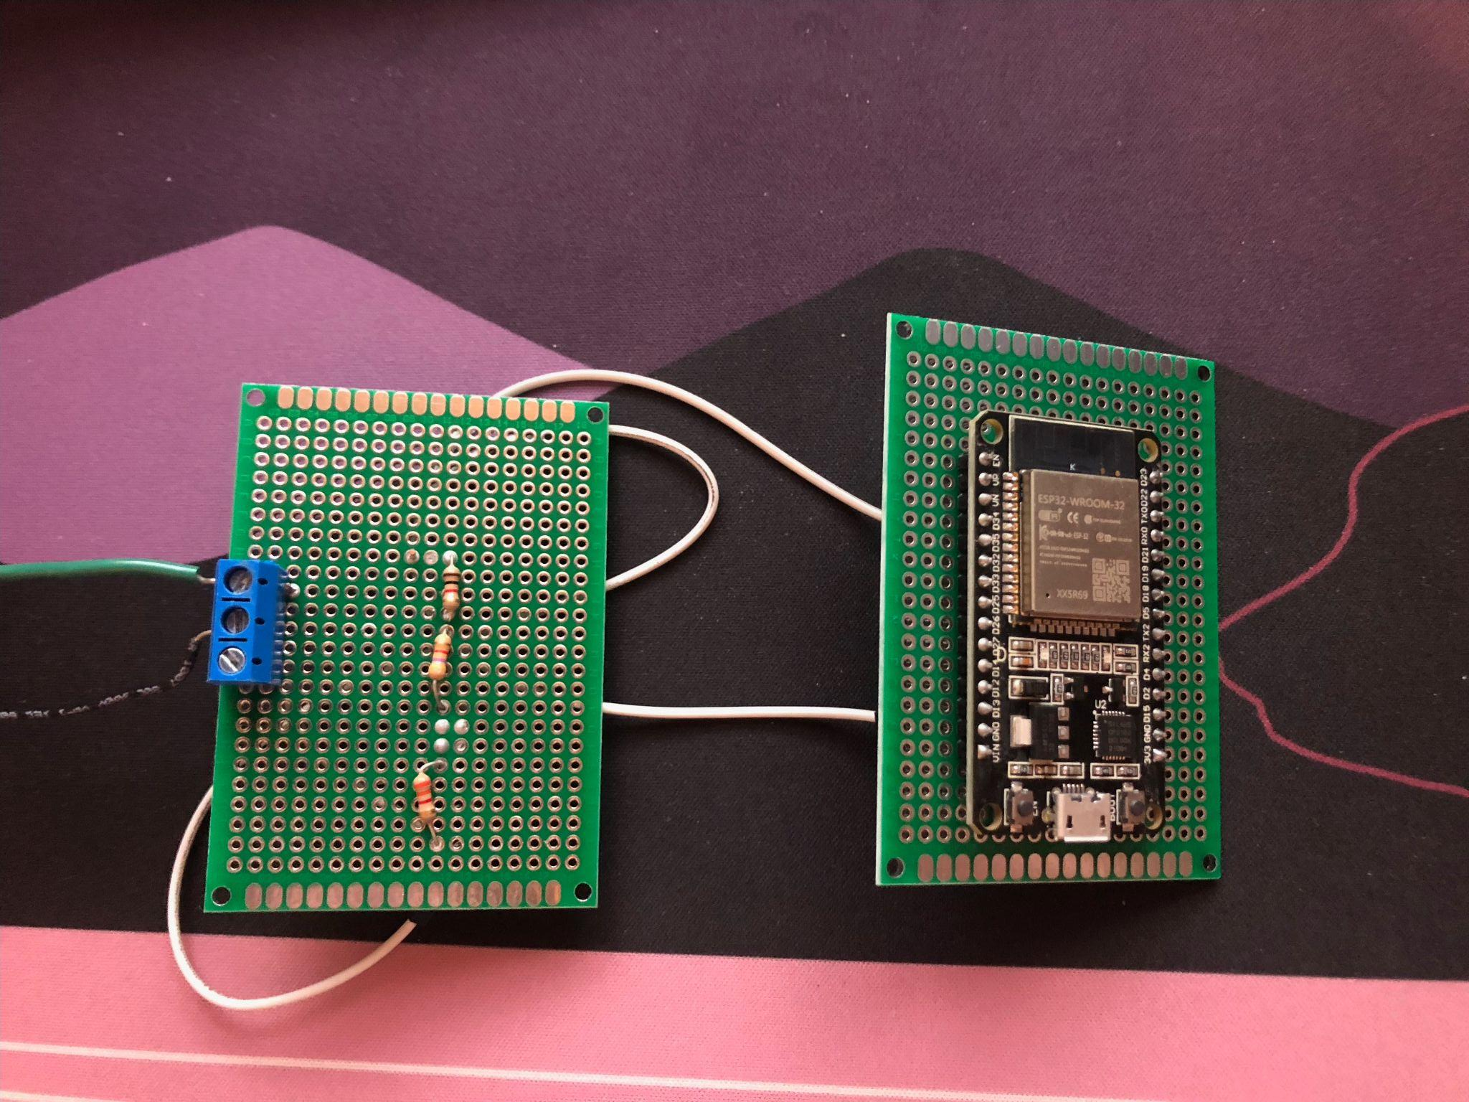
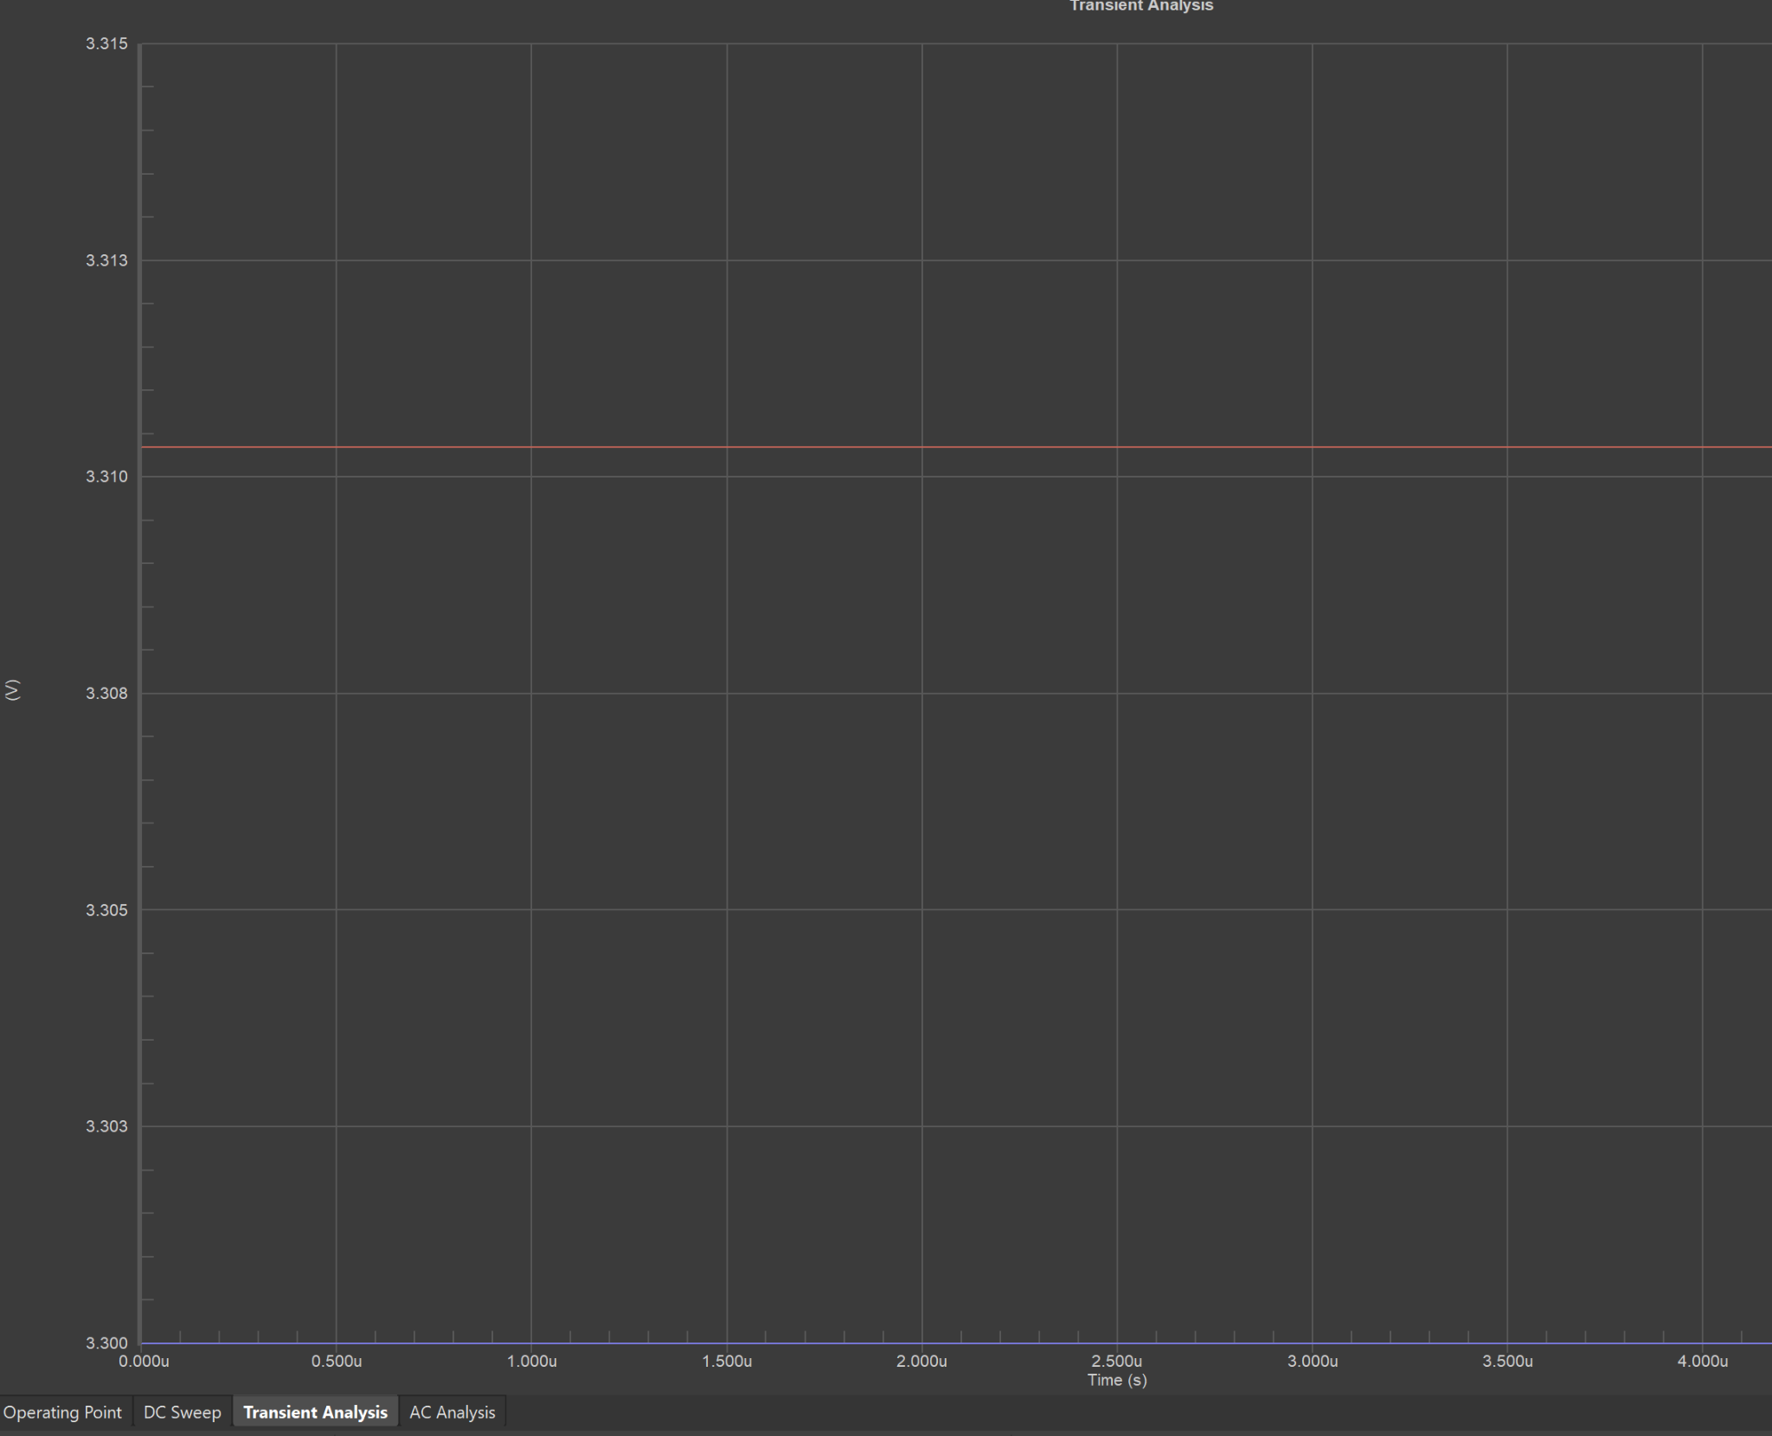
MCU Subsystem Lyndon Li
Accomplishments since the last presentation | Ongoing progress/problems and plans until the next presentation
Wrote Software for Testing Components <4> hrs Built Model for Testing <3> hrs Finished Preliminary PCB Schematic<6> hrs Finished Preliminary PCB Layout<6> hrs | Supply Power with Wall Adapter Write Logic Functions for Firmware Code for Bluetooth Data Transfer Code for Battery level Code for Charge Control Signal

Slide 6
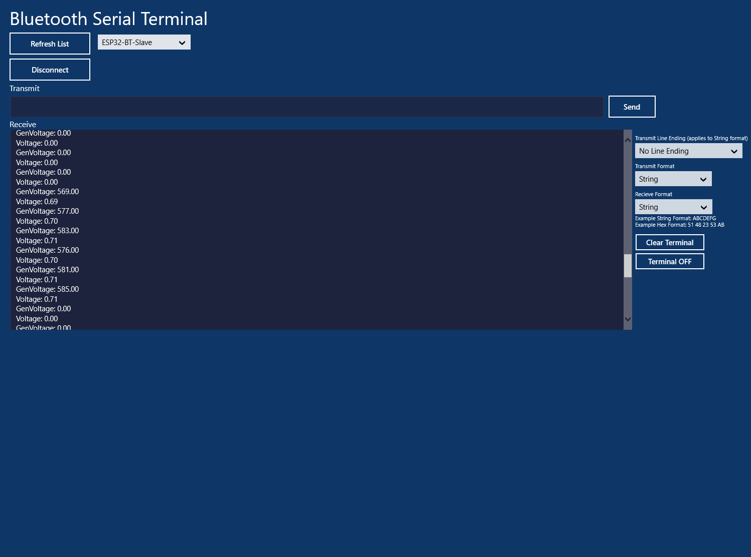
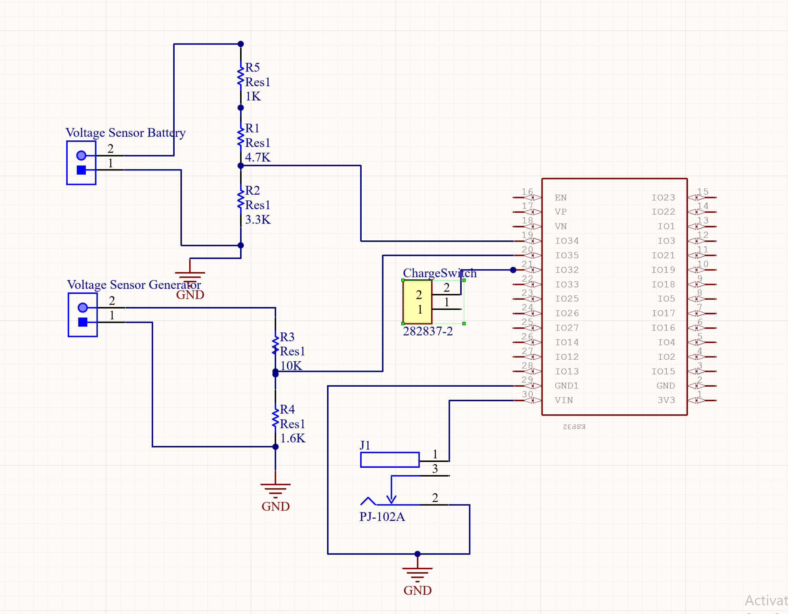
MCU Subsystem Cont. Lyndon Li
Test results
Multimeter: .7 - .8 V
MCU: .69 - .71 V

Slide 7
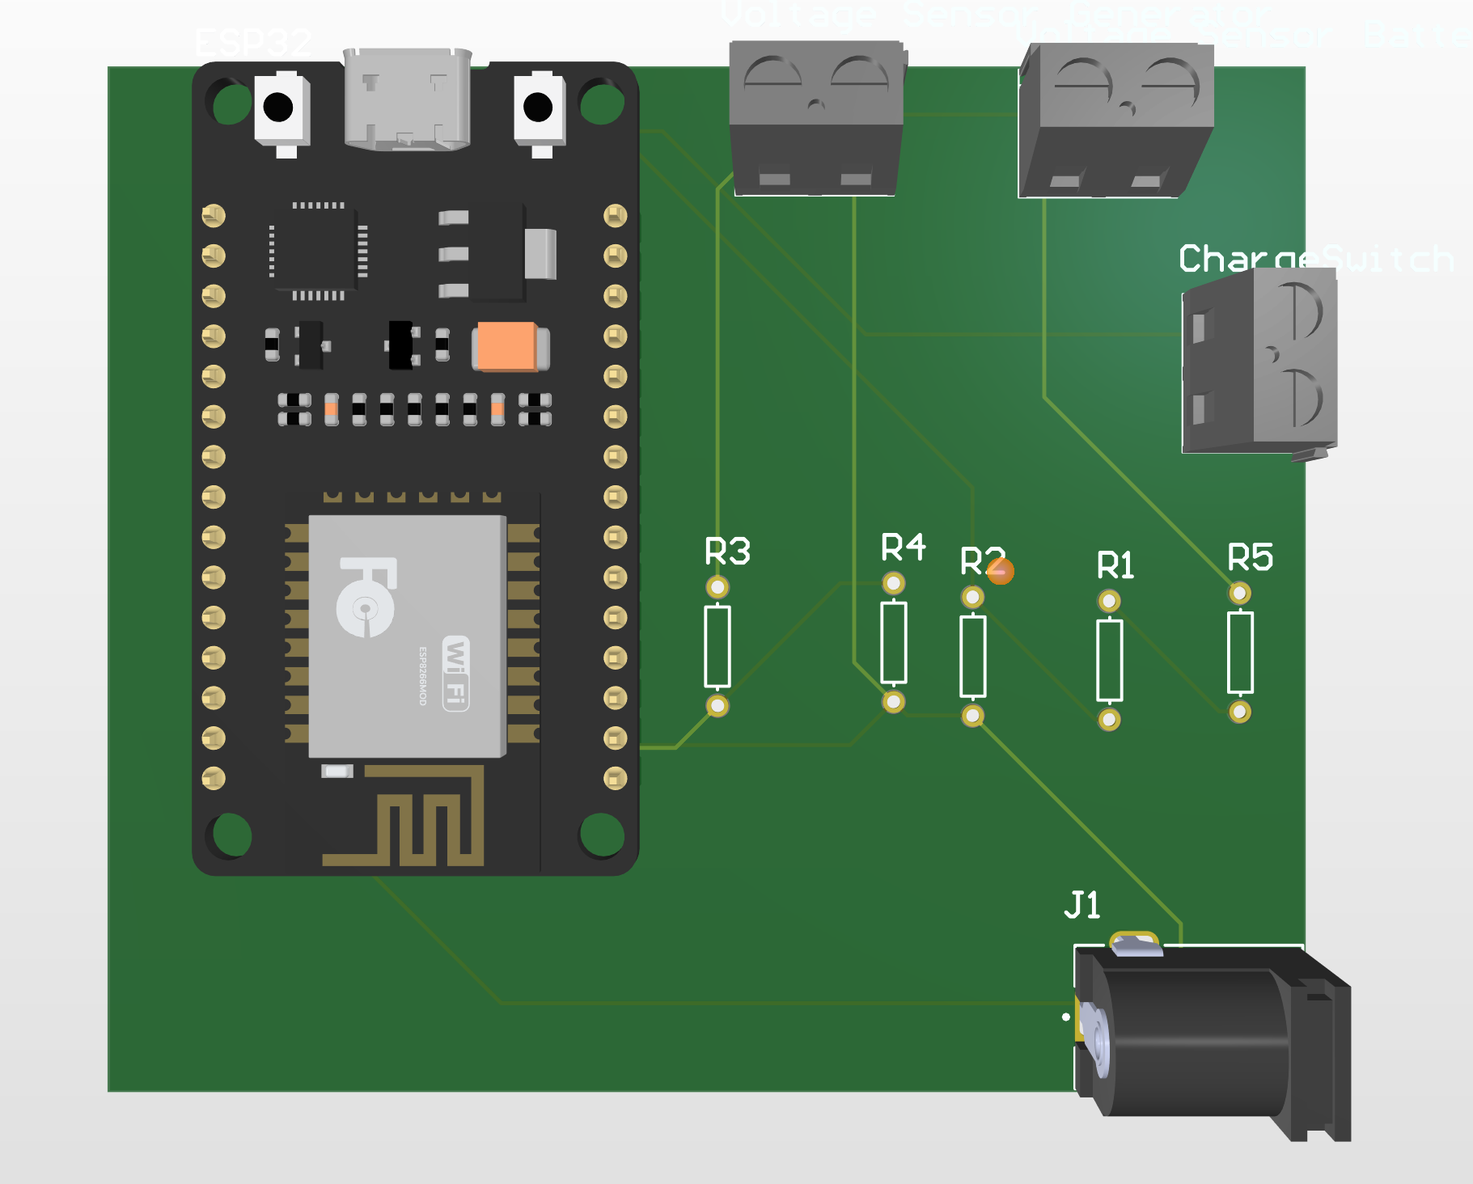
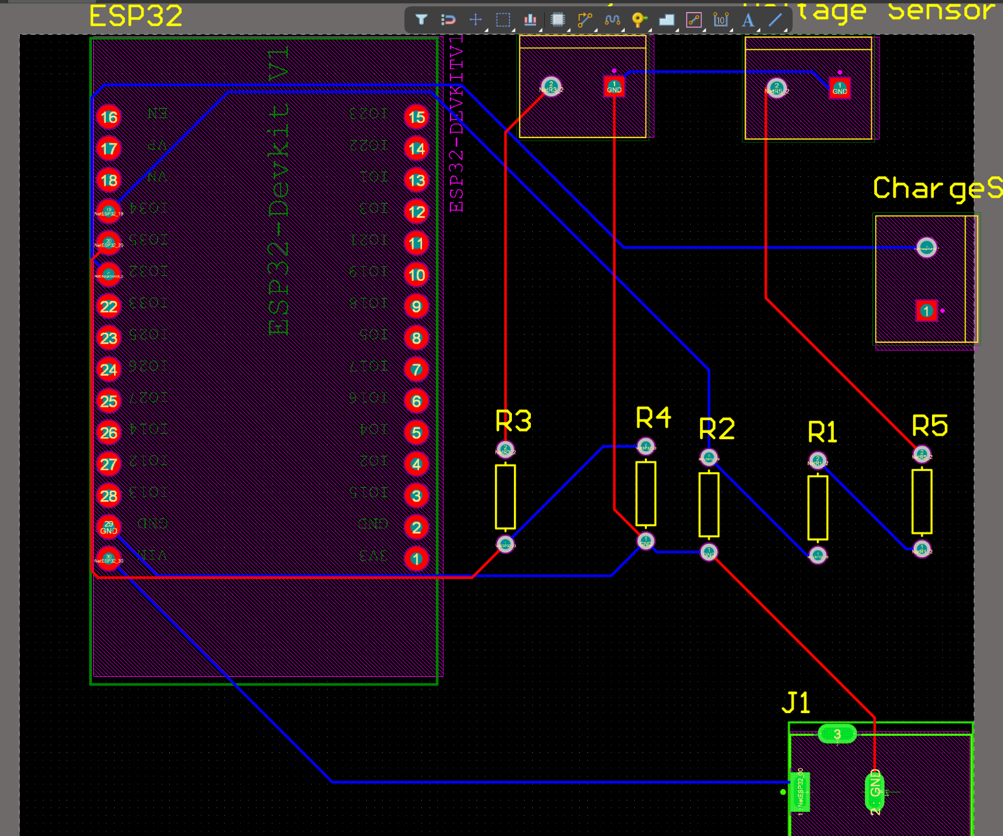
MCU Subsystem Cont. Lyndon Li

Slide 8
App Subsystem Christian Kirk
Accomplishments since the last presentation 10 hrs | Ongoing progress/problems and plans until the next presentation
landing page UI app able to run on device emulator and Moto e device transfer BLE data to Bluetooth scanner app | get Android device connected to ESP32 in our app display sensor values in the textViews on the landing page create additional app page for user interaction

Slide 9
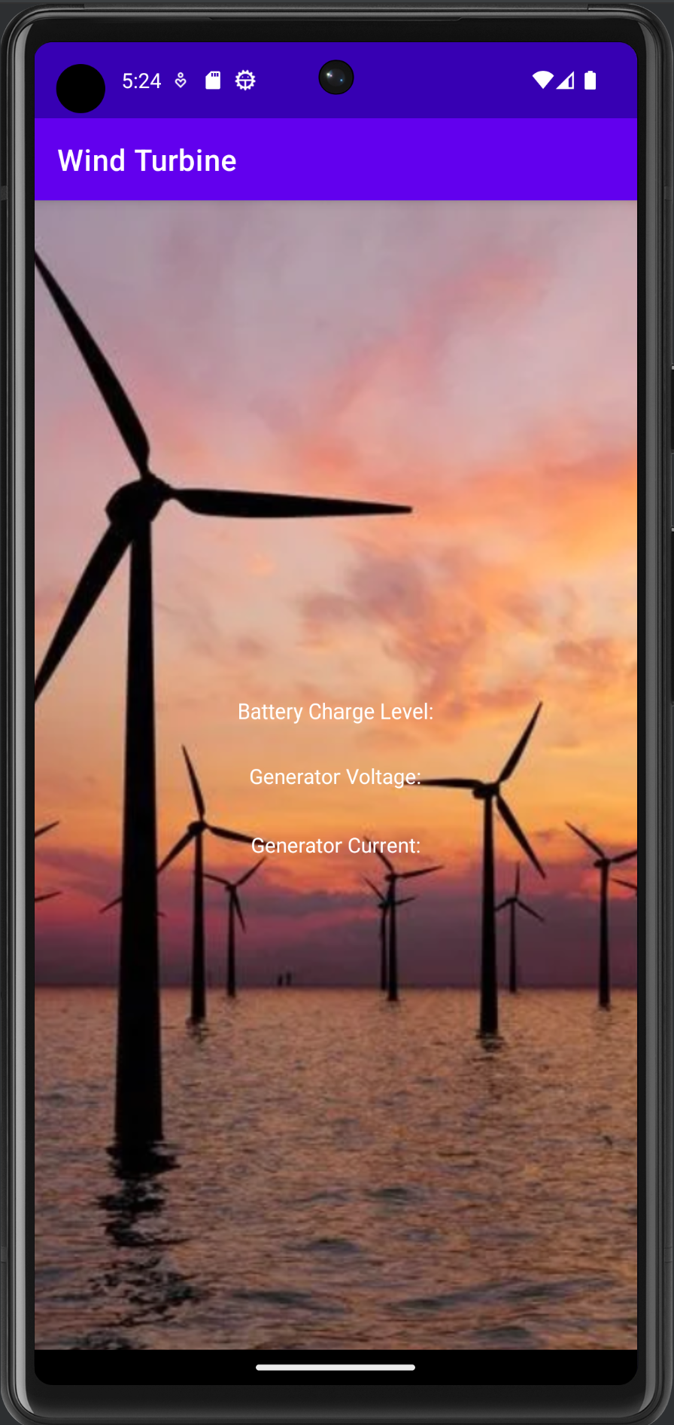
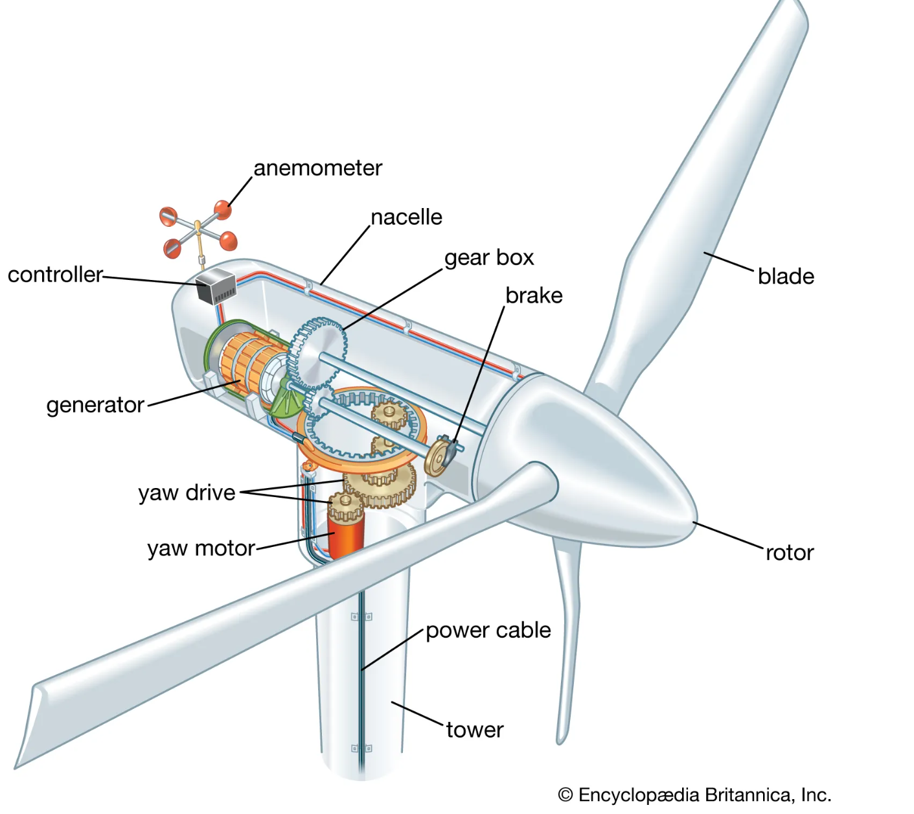
Landing Page
App Subsystem Cont. Christian Kirk
Interactive Display Page

Slide 10
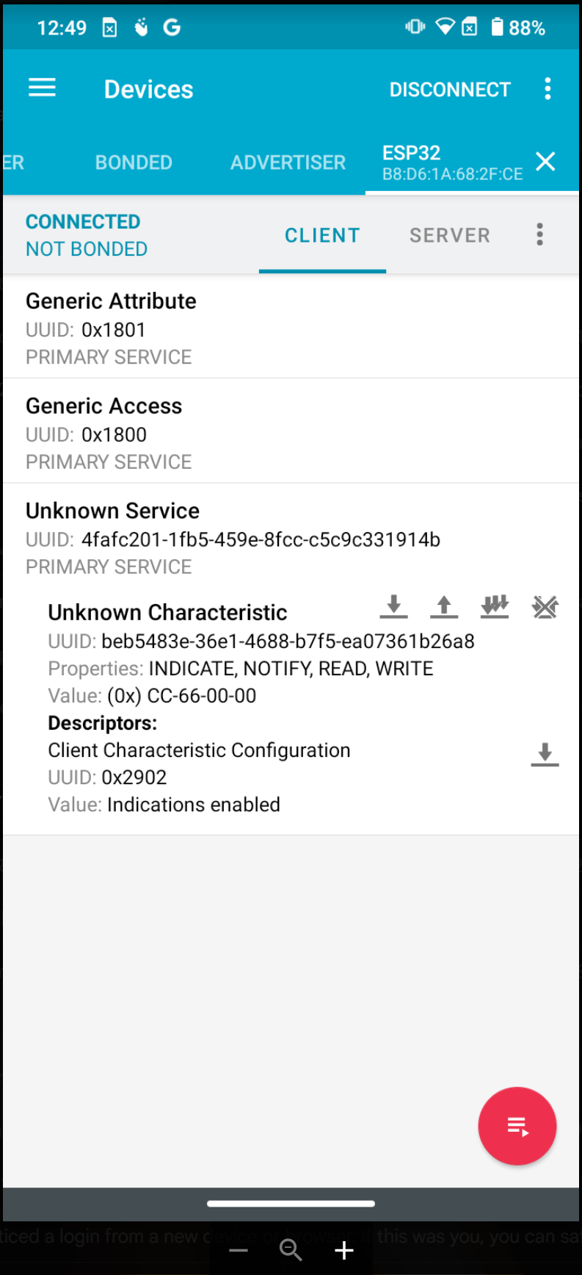
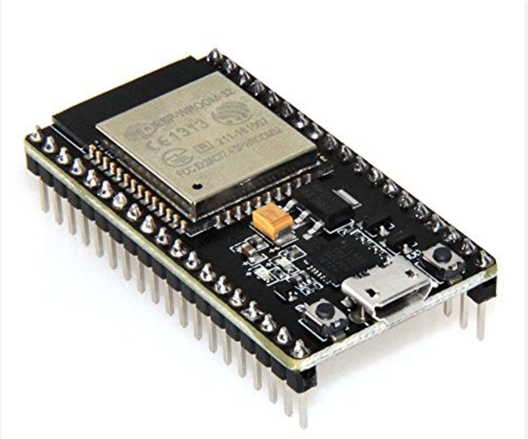
App Subsystem Cont. Christian Kirk
BLE Client
BLE Server

Slide 11
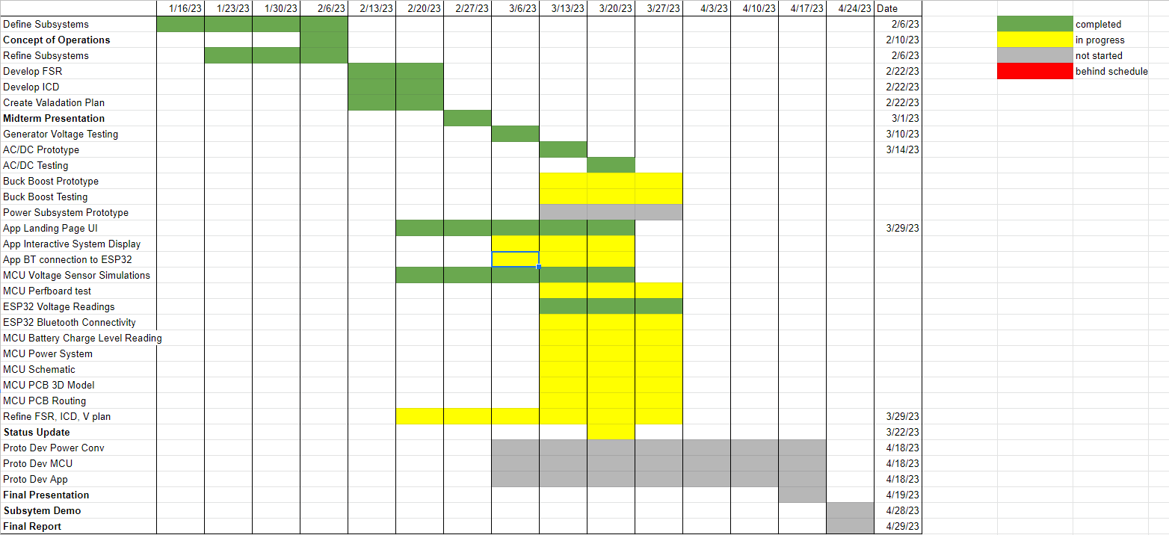
Team 12: Wind Power
Execution Plan

Slide 12
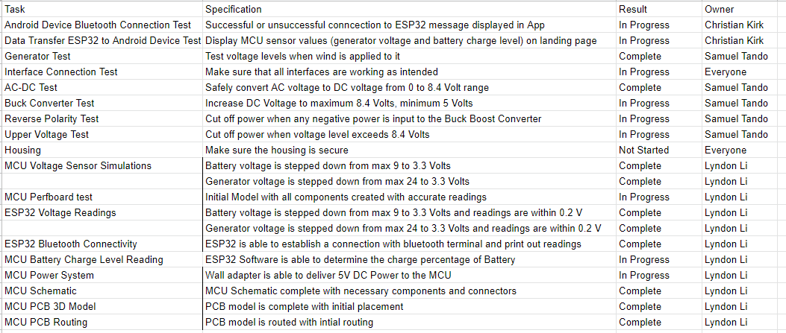
Team 12: Wind Power
Validation Plan

